Slide 1
Polycystic Ovary Syndrome
Detection from Images using
Deep Learning
By
GANESHKUMAR KARUNANIDHI

Slide 2
Abstract
Polycystic Ovary Syndrome (PCOS) is an endocrinological dysfunction prevalent among women of reproductive age. PCOS is a combination of syndromes caused by an excess of androgens — a group of sex hormones — in women, Syndromes including acne, alopecia, hirsutism, hyperandrogenemia, oligoovulation, etc. are caused by PCOS
It is also a major cause of female infertility. An estimated 15% of reproductive-aged women are affected by PCOS globally.

Slide 3
Dataset Description
Tools and Technologies used
A Datasets included ultrasound pictures of healthy ovaries as well as cystic ovaries .The ultrasound photos that showed infected cysts on the ovary were given the label ‘infected’ while the ultrasound images that showed a healthy ovary were given the label ‘not infected’.
In the Kaggle ,the Dataset have 2 different folder ,
I have take only train folder and then used for
As a Train data, test data and validation data.
Tensorflow
Keras
NumPy

Slide 4
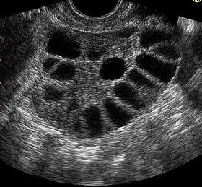
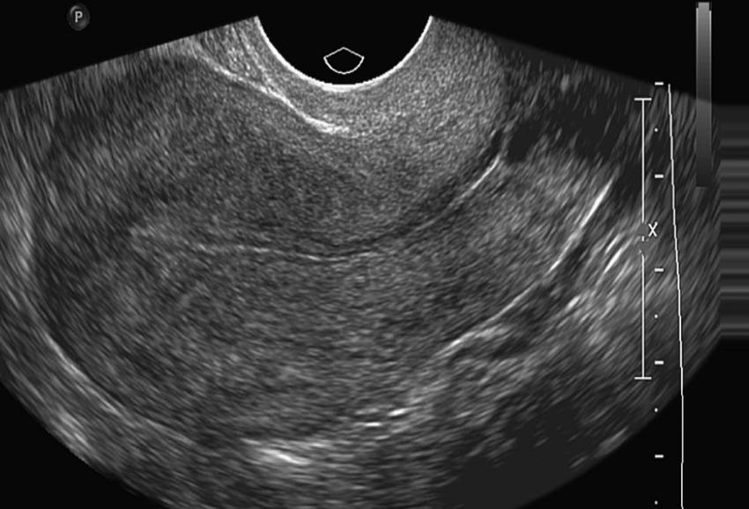
Sample Image
Infected
Not Infected

Slide 5
Image Preprocessing
our models with images of uniform dimensions, we have rescaled all the photos of both the datasets to 224×224 pixels.
ImagedataGenerator: Generate batches of tensor image data with real-time data augmentation.
We have used ImageDataGenerator from Keras to normalize our image data.

Slide 6
Model Description
We have use a Keras image classification model, optionally loaded with weights pre-trained on ImageNet.
After the we have to pass model output as a
Input of the Dence and Flatten layers

Slide 7
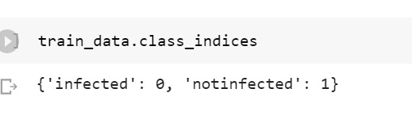
Class Indices of train, test and validation data

Slide 8
Result
we have developed MobileNetModel - a CNN model to classify polycystic ovarian ultrasound images
we get the 100 % accuracy, our model really perform well in a datasets
THANK YOU

